Slide 1

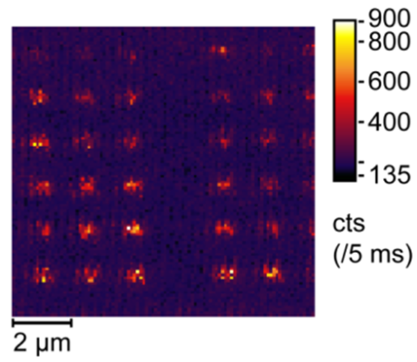
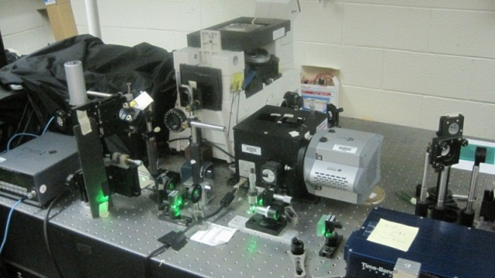
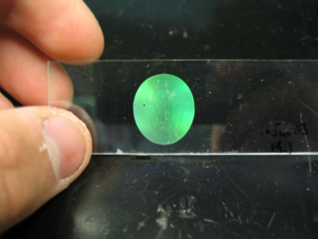
Однофотонные источники света для надежной квантовой коммуникации
Др. Светлана Г. Лукишова
Институт Оптики, Рочестерский Университет, США
E-mail: sluk@lle.rochester.edu
Московский Инженерно-Физический Институт, 26 сентября 2014

Slide 2


Slide 3
Conference: Quantum-Physics-Based Information Security
Monday - Tuesday 22-23 September 2014, Amsterdam
1: Satellite Quantum Communication
2: Photon Sources, Transceivers, and Repeaters for Quantum Information Systems
3: Implementation of Quantum Key Distribution and other Quantum Protocols
4: Continuous Variables Approaches to Quantum Key Distribution
5: Quantum Computation and Quantum Information Theory

Slide 4

Доклад состоит из следующих частей:
статистика различных фотонных источников,
популярный протокол BB84 для квантовой криптографии с поляризованными одиночными фотонами,
излучатели для источников одиночных фотонов, работающих при комнатной температуре (коллоидные полупроводниковые квантовые точки, центры окраски в наноалмазах, трехвалентные редкоземельные ионы в нанокристаллах),
фотонные и плазмонные наноструктуры для управления излучением одиночных фотонов и методы их изготовления.

Slide 5
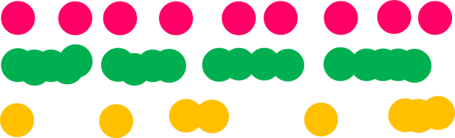
Photon-counting and photon statistics
Photon counting is a technique at a low-light level in which individual photons are counted using a single-photon detector.
The following photodetectors can be used to detect individual photons: human eye, high-sensitive photographic plates, cooled photomultiplier tubes, single-photon avalanche photodiodes, superconducting single-photon detectors, cooled CCD-cameras with electron multiplication (EM) or intensified (with a microchannel plate).
Vavilov and Brumberg: observation of quantum fluctuations of light in 1930s

Slide 6
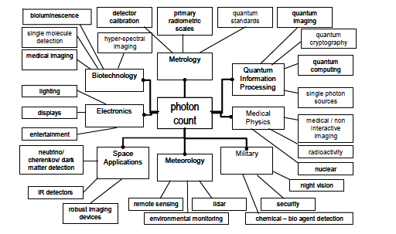
PHOTON COUNTING APPLICATIONS
Single-photon detection is used in many fields including quantum optics and quantum information, astronomy, nanophotonics, fiber-optical communication, medical imaging, material science, etc.

Slide 7
Photon statistics
The number of photons observed per unit time (photons/s) is the photon flux
If we have a 633 nm wavelength He-Ne laser beam with a power 1 mW and attenuate it with glass filters by a factor 10⁶ , we will obtain 1 nW power. The average photon flux is φ = P/hν = 3.1 x 10⁹ photons/s.
Since the velocity of light is 3 x 10⁸ m/s, we expect to have an average 31 photons within a 3 m segment of a such beam.
On a very small length of a segment, the fluctuation become very apparent. For example, in a 3 cm segment of a beam corresponding to a time interval of 100 ps, the average photon number falls to 0.31. The majority of beam segments are now empty, and a sequence of 10 beam segments equivalent to a 30 cm beam segment might look like: 1,0,0, 1,0,0,0,0,0,1. This sequence has a sum 3, a mean of 0.3, and a standard deviation of 0.46.
Although the average photon flux can have a well-define value, the photon number on short time-scales fluctuate due to the discrete nature of the photons. These fluctuations are described by the photon statistics of the light.

Slide 8
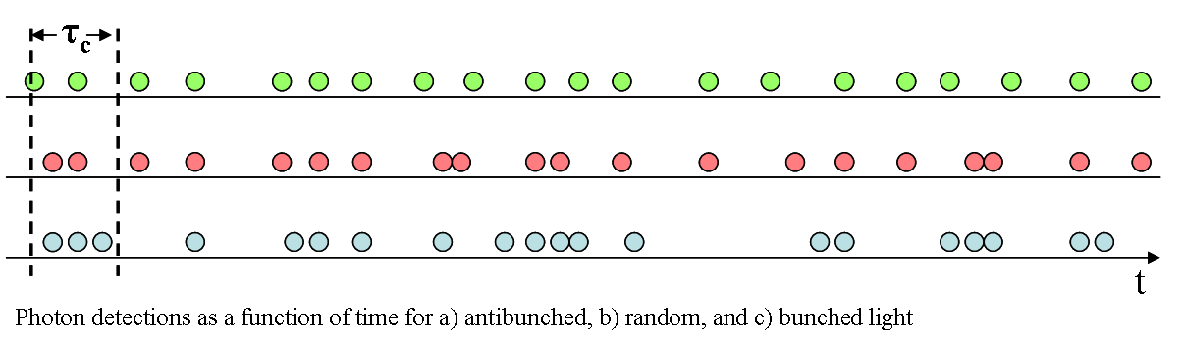
Photon statistics
For different light sources there are 3 types of photon statistics:
Poissonian (coherent light from the laser)
super-Poissonian (thermal light (bunched))
sub-Poissonian (antibunched light)

Slide 9
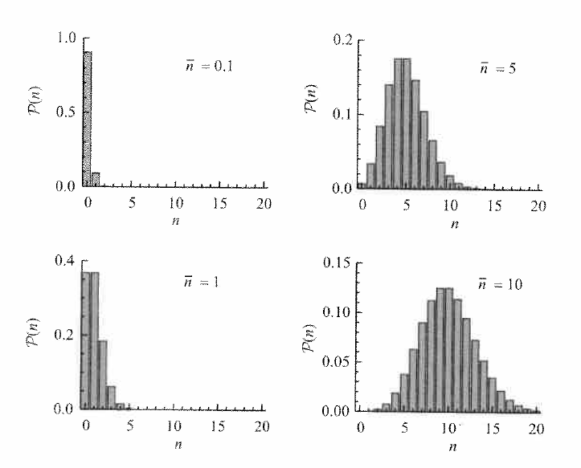
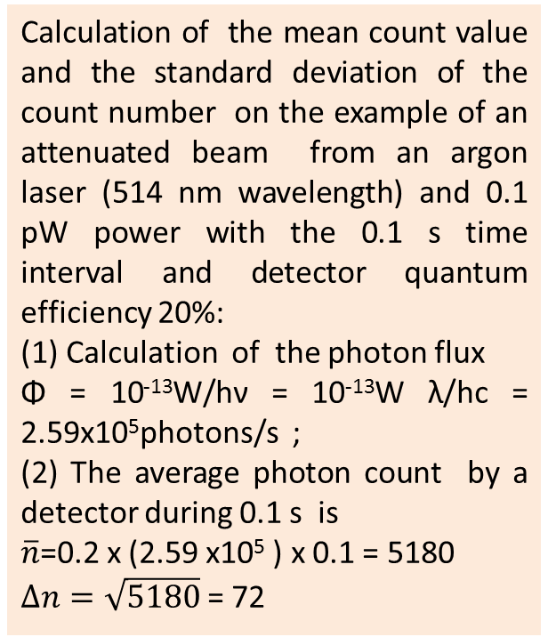

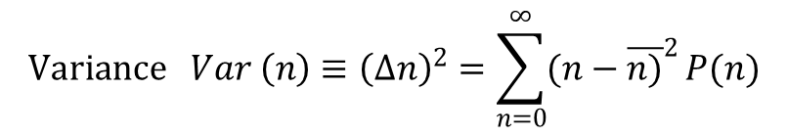
Coherent (laser) light: Poissonian photon statistics
$Probability P\left(n\right)=\frac{{\overline{n}}^{n}}{n!}\exp{(−\overline{n}} )$, n = 0, 1, 2,…
$$Variance Var \left(n\right)≡{\left(∆n\right)}^{2}=\sum_{n=0}^{∞}{{(n−\overline{n)}}^{2}}P(n)$$
The standard deviation $∆n= \sqrt{\overline{n}}$
Calculation of the mean count value and the standard deviation of the count number on the example of an attenuated beam from an argon laser (514 nm wavelength) and 0.1 pW power with the 0.1 s time interval and detector quantum efficiency 20%:
(1) Calculation of the photon flux
Φ = 10⁻¹³W/hν = 10⁻¹³W λ/hc = 2.59x10⁵photons/s ;
(2) The average photon count by a detector during 0.1 s is
$\overline{n}$=0.2 x (2.59 x10⁵ ) x 0.1 = 5180
$∆n=\sqrt{5180}$= 72

Slide 10
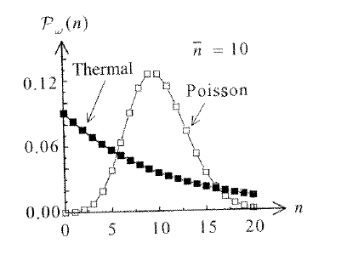
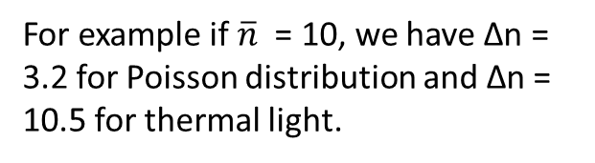
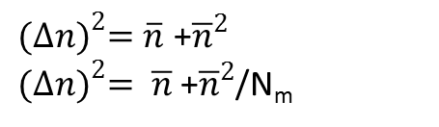
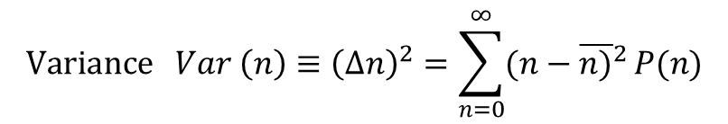
Super-Poissonian light (thermal light and chaotic light)
$$Bose−Einstein distribution P\left(n\right)=\frac{1}{1+\overline{n}} {\left(\frac{\overline{n}}{1+\overline{n}}\right)}^{n}$$
$$Variance Var \left(n\right)≡{\left(∆n\right)}^{2}=\sum_{n=0}^{∞}{{(n−\overline{n)}}^{2}}P(n)$$
${(∆n)}^{2}=\overline{n}$ +${\overline{n}}^{2}$
${(∆n)}^{2}= \overline{n}$ +${\overline{n}}^{2}$/N_{m}
The variance of the Bose-Einstein distribution is always larger than that of a Poisson distribution and that thermal light therefore falls into the category of super-Poissonian light.
For example if $\overline{n}$ = 10, we have Δn = 3.2 for Poisson distribution and Δn = 10.5 for thermal light.

Slide 11
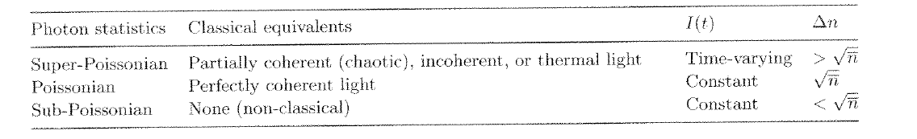
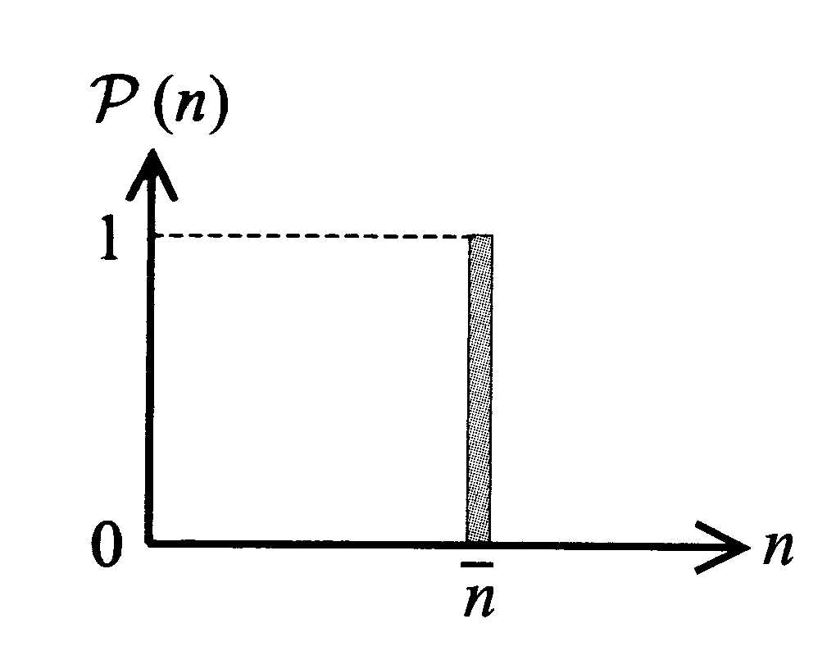
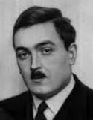
Sub-Poissonian light
Fock states
Sub-Poissonian light is defined by the relation:
Sub-Poissonian light has no classical equivalent. Therefore, the observation of sub-Poissonian statistics is a clear signature of the quantum nature of light.
If Δn = 0, this light calls photon number state

Slide 12
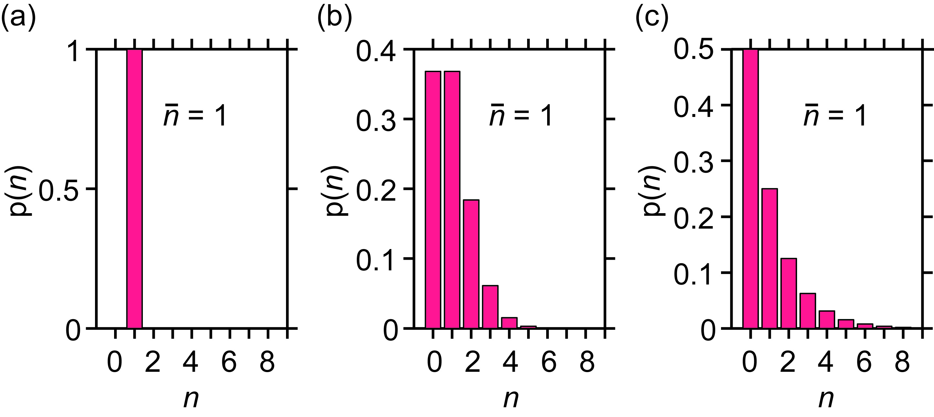
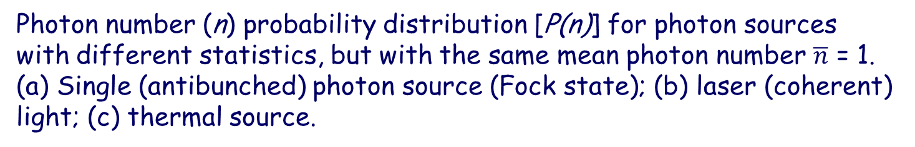
Photon number (n) probability distribution [P(n)] for photon sources with different statistics, but with the same mean photon number $\overline{n}$ = 1. (a) Single (antibunched) photon source (Fock state); (b) laser (coherent) light; (c) thermal source.

Slide 13
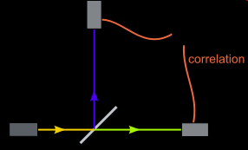
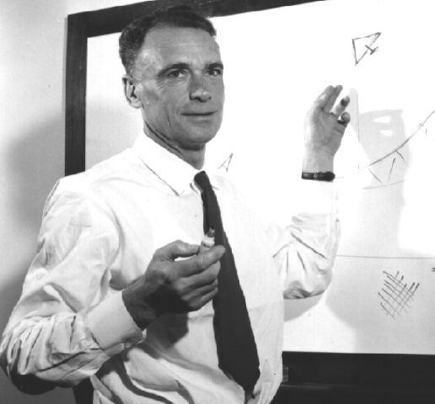
Photon bunching
In 1956, R.H. Brown and R.Q. Twiss observed the existence of correlation between the outputs of two photoelectric detectors illuminated by partially correlated light waves [Nature, 111, 27 (1956)].
Hanbury Brown and Twiss intensity interferometer

Slide 14
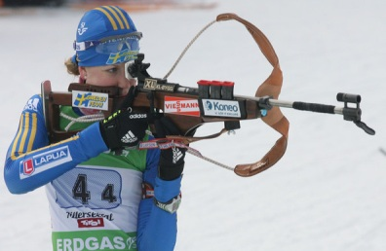

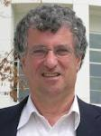
Photon ANTIBUNCHING was first demonstrated at the University of Rochester (Department of Physics and Astronomy) in 1977
H.J. Kimble, M. Dagenais, and L. Mandel, Phys. Rev. Lett. 39, 691 (1977).

Slide 15
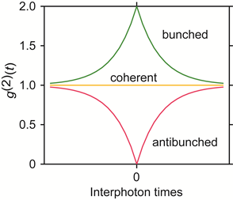
Second order correlation function

Slide 16
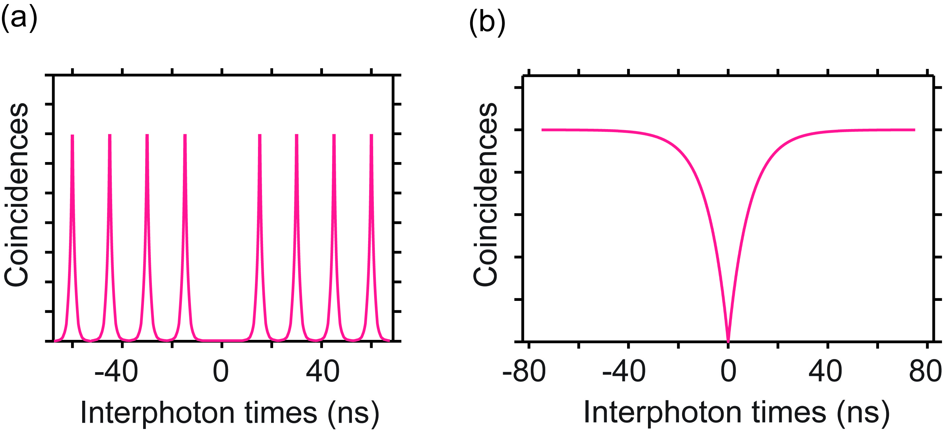

To produce single (antibunched) photons, a laser beam is tightly focused into a sample area containing a very low concentration of emitters, so that only one emitter becomes excited. It emits only one photon at a time.
To enhance single photon efficiency and single photon emission rate a cavity or nanoantenna should be used

Slide 17
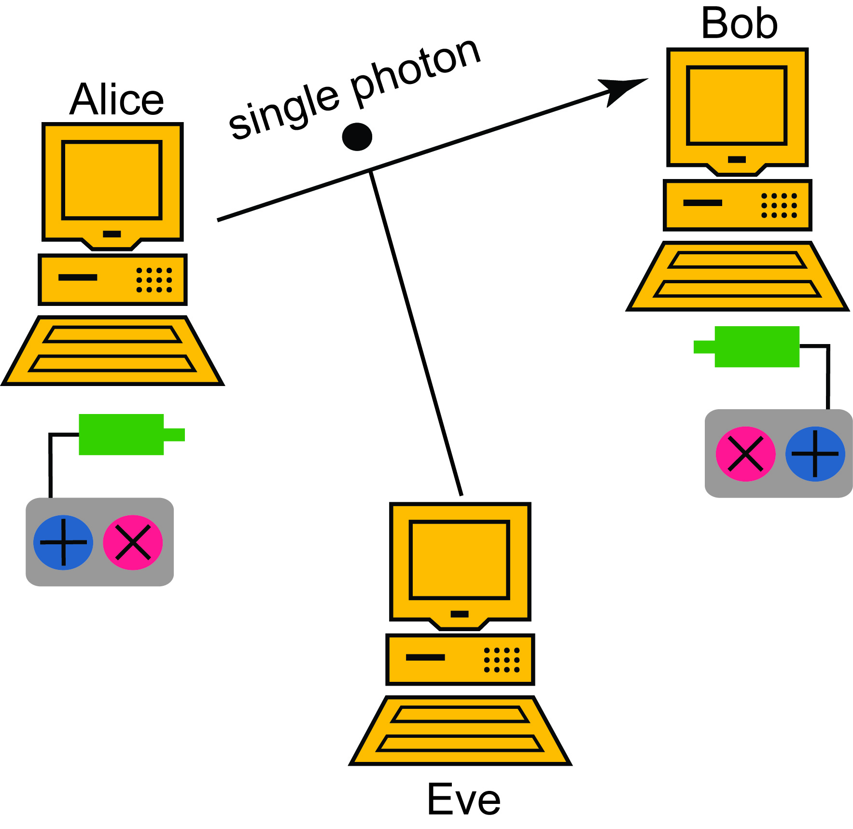
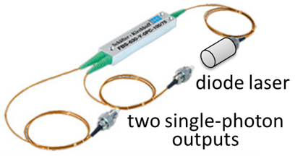
Room-temperature device: efficient, portable, polarized, stable, ease of use and fabrication, tunable single photon source on demand
Hybrid nanophotonics-nanoplasmonic structure with single emitters on a facet of optical fiber
Applications:
Free-space and fiber-based quantum cryptography;
Some quantum computation protocols;
Fundamental physics experiments

Slide 18



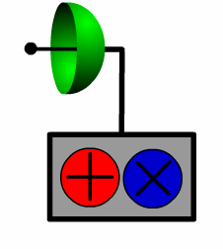
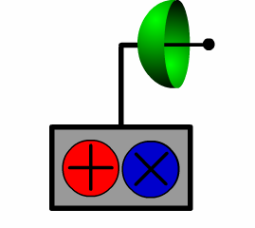
Why do we need QUANTUM cryptography?
Powerful quantum computers will brake all of our commonly used public-key algorithms.
Absolutely secure quantum communication using single photons
Eve
In 1984 and 1991, the first protocols for quantum cryptography attracted interest from a diverse field of researchers in theoretical and experimental physics, mathematics and computer science.

Slide 19
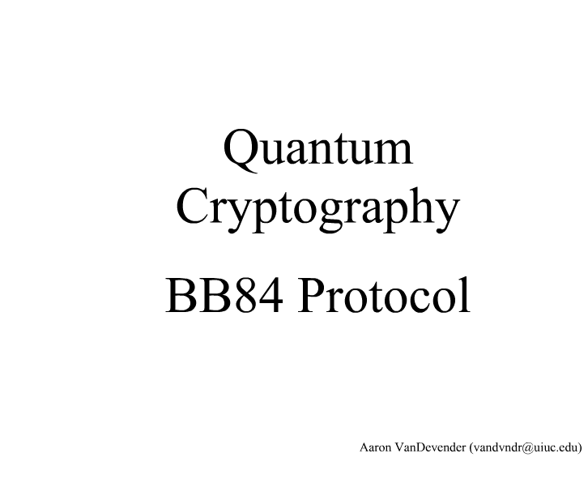
Notes:
19

Slide 20
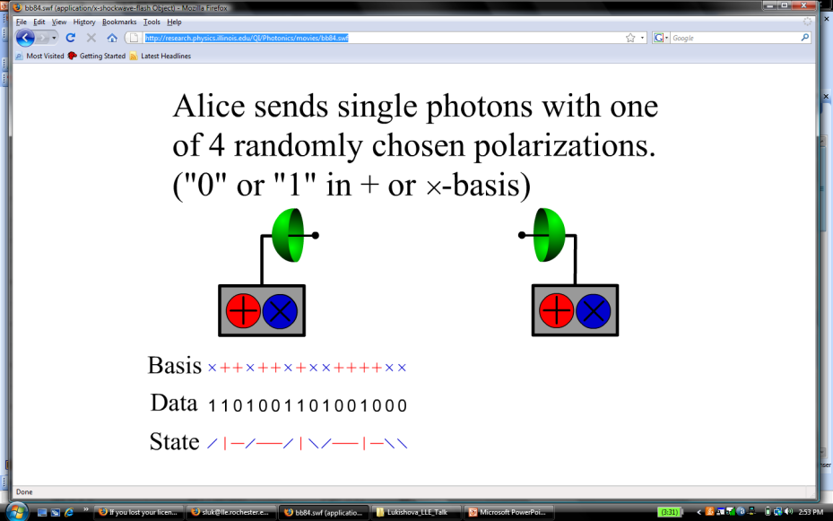
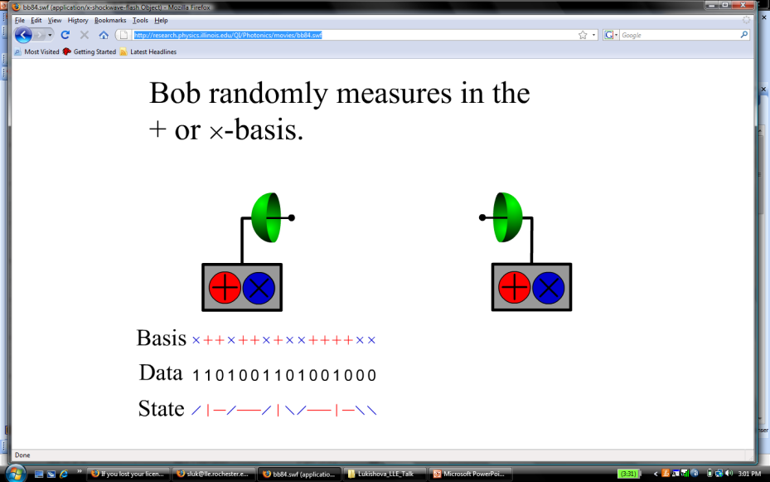
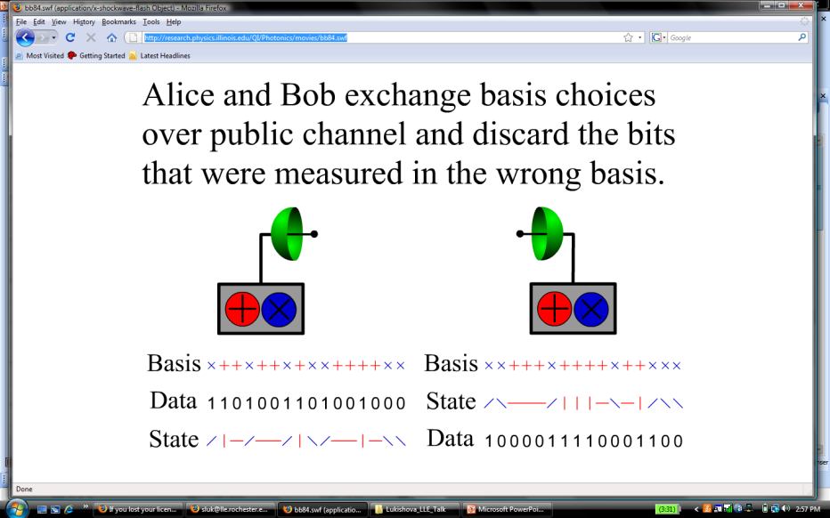
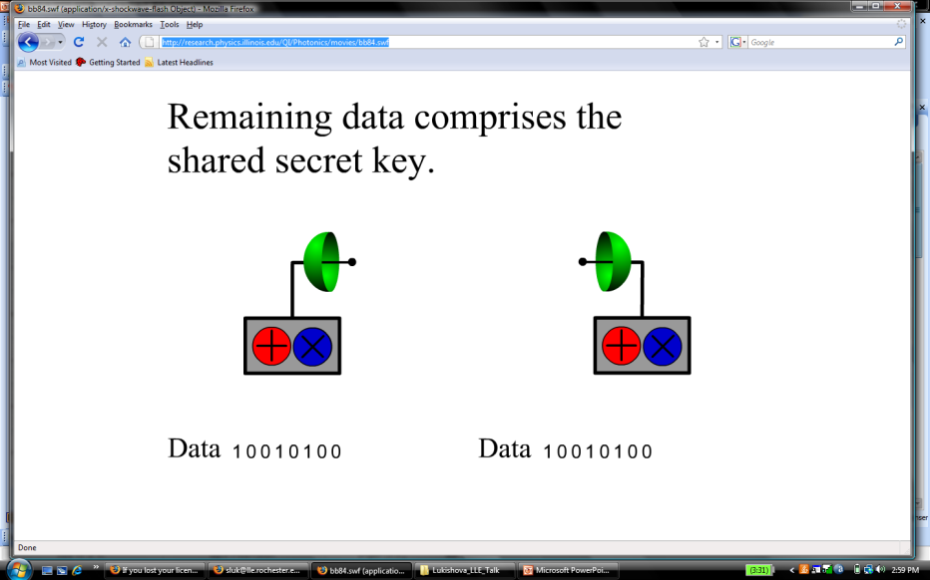
Quantum cryptography BB84 protocol from http://research.physics.illinois.edu/QI/Photonics/movies/bb84.swf
Perpendicular polarizations of single photons encode 0’s and 1’s in two different bases

Slide 21
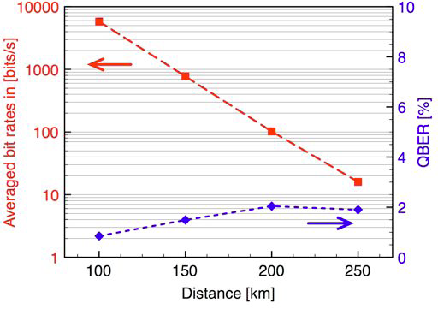

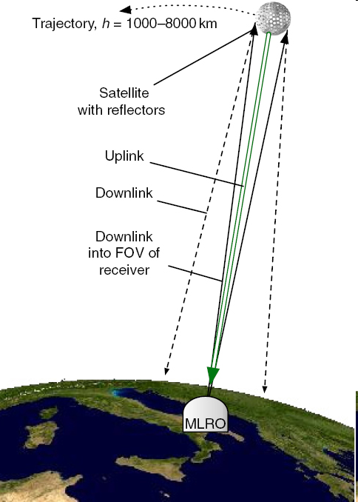

How far single photons can propagate
In Space
Fiber optics
(using a satellite and the telescope at the Matera Laser Ranging Observatory of the Italian Space Agency)
(with extremely low losses)
Quantum key distribution over 250 km with faint laser pulses (OBER is errors in %)
Detection of faint laser pulses with average 0.5 photons/pulse through 1,485 km
ArXiv: 0903.3907, March 2009 (N. Gisin’s group jointly with Corning ).
New J. Phys. 10 (2008) 033038 (A. Zeilinger’s group)
Notes:
Extending quantum communication to space environments would enable us to perform fundamental experiments on quantum physics as well as applications of quantum information at planetary and interplanetary scales. Here, we report on the first experimental study of the conditions for the implementation of the single-photon exchange between a satellite and an Earth-based station. We built an experiment that mimics a single photon source on a satellite, exploiting the telescope at the Matera Laser Ranging Observatory of the Italian Space Agency to detect the transmitted photons. Weak laser pulses, emitted by the ground-based station, are directed toward a satellite equipped with cube-corner retroreflectors. These reflect a small portion of the pulse, with an average of less-than-one photon per pulse directed to our receiver, as required for faint-pulse quantum communication. We were able to detect returns from satellite Ajisai, a low-Earth orbit geodetic satellite, whose orbit has a perigee height of 1485 km.

Slide 22
Long-operational lifetime single-emitter nanocrystals for room-temperature single-photon sources
colloidal semiconductor quantum dots (or rods);
nanodiamonds with different color-centers;
nanocrystals doped with trivalent ions of rare-earths.
An ideal emitter for single-photon source application:
free from bleaching and blinking (photostable emission);
high quantum efficiency;
short fluorescence lifetime (less than 10 ns for 0.1 GHz pumping rate);
narrow photoluminescence linewidth;
definite polarization of emission.

Slide 23
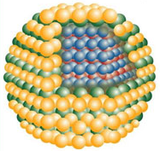
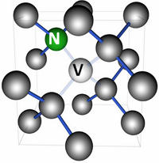
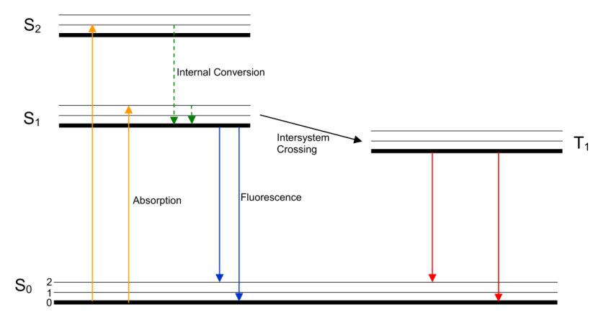
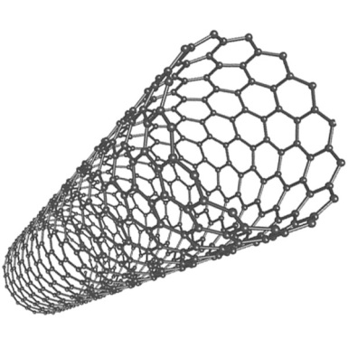
Some examples of single emitters
Dye molecules
Quantum dots
Nitrogen vacancy (NV) color centers in nanodiamonds
Single-walled carbon nanotubes
Quantum dot
Color center in nanodiamond
Energy level diagram of an organic dye molecule
Carbon nanotube

Slide 24
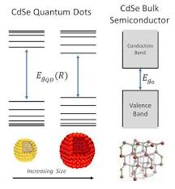
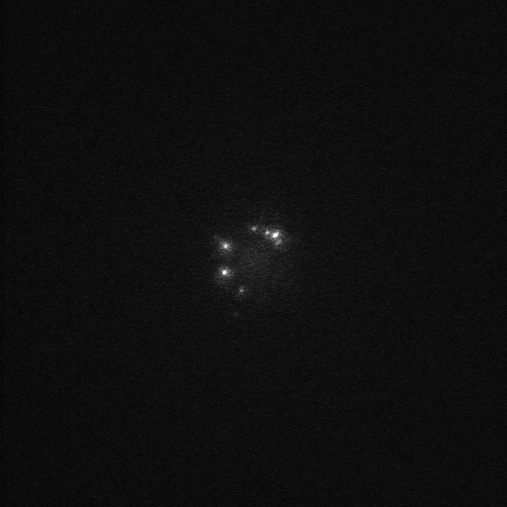
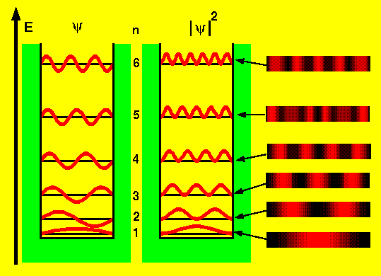
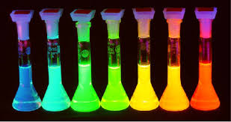
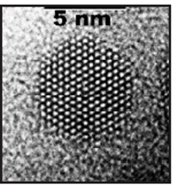
Colloidal nanocrystal quantum dots
Quantum particles in the box

Slide 25
Colloidal nanocrystal quantum dots (NQDs)
NQDs’ advantages:
very high fluorescence brightness (QE up to 100%).
fluorescence at optical communication wavelengths 1.3 and 1.5 μm;
relatively small sizes (few nms) that are good for doping;
possibility to reach g⁽²⁾(0) = 0;
the possibility of electroluminescence from a NQD
NQDs’ disadvantages:
usually occasionally strong, unpredictable blinking (although in papers^{1,2} NQD blinking was avoided. There is a new direction of quantum dot-in-rod core/shell nanoparticles² with a spherical core surrounded by a rod-like shell with relatively stable fluorescence without blinking).
clustering in solutions of some NQDs;
multiexponential fluorescence decay of some NQDs;
sometimes fluorescence decay constants of NQDs from the same solution (even on the same glass cover slips) strongly vary from one dot to another. It prevents meaningfully measuring the Purcell factor of some NQDs.
1. X. Wang et al., Nature 459, 686 (2009).
2. F. Pisanello et al., Adv. Mater, 25, 1974 (2013).

Slide 26

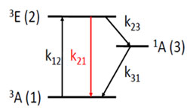
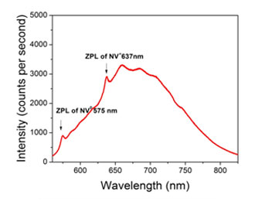
NV-color center diamonds

Slide 27

Color-center nanodiamonds
 | ZPL, nm | FWHM,nm | Lifetime,ns | Count rate, c/s | Quant. Eff.
TR12, bulk | 470 | - | ~3.6 | - | -
NV⁻ , bulk | 637 | ~100 | 11 | 1.7 x 10⁵ (with nanoantenna) | 0.7
NV⁻ , nanodiam. | 637 | ~100 | ~20 | 2.4 x 10⁶ (with solid immersion lens) | -
Unidentified center | 734 | ~4 | ~13.6 | 1.8 x 10⁶ | -
SiV , bulk | 738 | ~10 | ~1.1 | 1 x 10³ | 0.05
SiV, nanodiam. | 738 | ~10 | ~1.1 | 4.8 x 10⁶ (on iridium substrate) | -
Cr, bulk | 749 | ~4 | ~1 | 0.5 x 10⁶ | 0.29
Cr, nanodiam. | 756 | ~11 | ~3.5 | 3.2 x 10⁶ | > 0.9
Ni/Si, bulk | 768 | ~5 | ~2 | 2 x 10⁵ | -
Ni/Si, bulk | 773 | ~3 | ~1.1 | 7.7 x 10⁴ | -
NE8, bulk | 802 | ~2 | ~1.1 | 7.5 x 10⁴ | 0.7
NE8,nanodiam. | 793.7 | ~2 | ~2 | 3.5 x 10⁴ | -
Aharonovich et al., Pep. Prog. Phys. 74, 076501 (2011).
Schroder et al., New J. Phys.13, 055017 (2013).
Leifgen et al., New J. Phys. 16,023021 (2014).

Slide 28
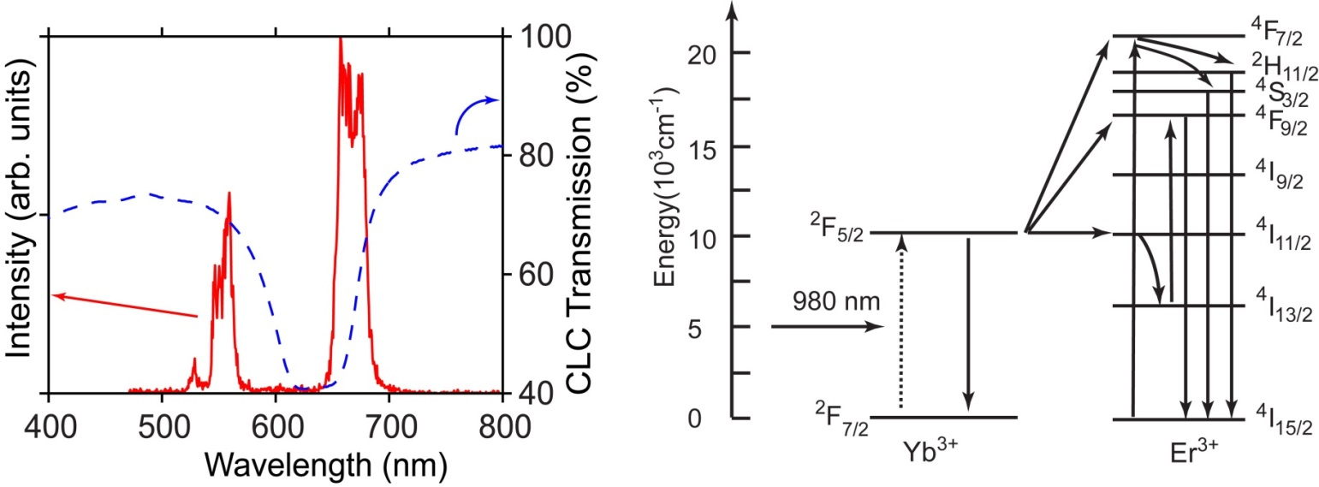
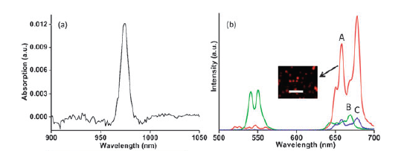
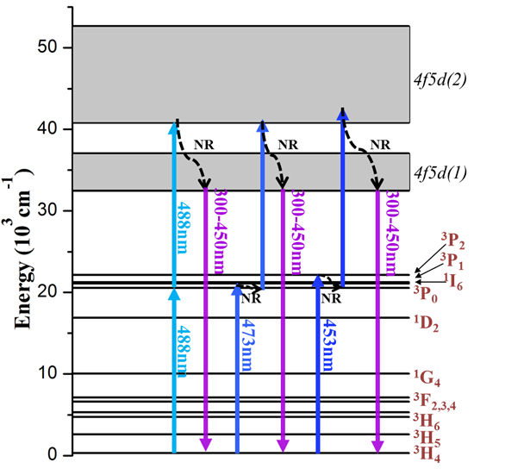
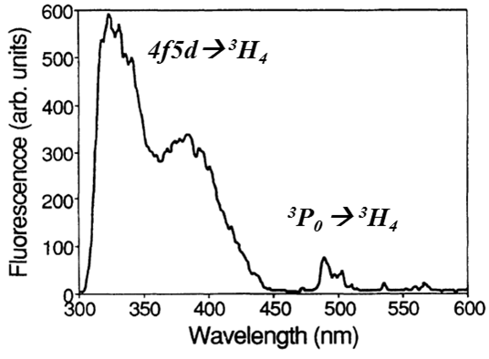


Nanocrystals doped with trivalent rare-earth ions
Common forbidden transitions
CeO₂: Er,Yb decay time of 10.6 μs
Babu et al., Chem. Commun. 46, 6915 (2010)
Schietinger, S., PhD Dissertation, Humboldt Univ., Berlin (2012).
Allowed transitions
YAG: Pr, 18 ns (4f5d)
Kolesov et al., Nature Commun.3, 1029 (2012).

Slide 29




Solid immersion lenses and fiber-based Fabry-Perot microcavity for single-emitter nanocrystals
Schroder et al., New J. Phys. 13, 55017 (2011).
40 photons/sGHz
Leifgen et al., New J. Phys. 16, 023021 (2014).
Albrecht et al., Phys. Rev. Lett. 110, 243602 (2013).
Linewidths of 46 and 90 GHz and count rates of 700 and 3700 counts/s (17 and 41 photons/sGHz). Without cavity – 4.5 photons/sGHz.

Slide 30



Single-photon sources: state-of-the art
Purcell effect (spontaneous emission enhancement in the microcavity)
Purcell factor F equals to γ/γ₀ ~ Q/V. Here γ and y₀ are the spontaneous emission rates (γ = 1/τ, where τ is the fluorescence lifetime) at the cavity resonant wavelength, and in free space respectively, Q is a cavity quality factor, V is the mode volume.
Review: Y. Yamamoto et al., Progress in Informatics 1, 5-37 (2005).

Slide 31




Single-photon sources based on color-centers in diamond
O. Benson’s group (Berlin)
B.J.M. Haussman et al., Nano Letts.12, 1578 (2012)
B.J.M. Haussman et al., Nano Letts.12, 1578 (2012)

Slide 32


Fluorescence rate enhancement using nanoplasmonics and metamaterials
, 4
Hyperbolic metamaterial: alumina membrane with circular silver nanowires coated with dye-doped polymeric film.
Bowtie nanoantennas
W.E. Moerner’s group(Stanford University), Nano Letters 4 957 (2004)
M. Noginov, E. Narimanov et al., Opt. Lett. 35, 1863 (2010).

Slide 33


Bow-tie plasmonic nanoantennas
1340 times fluorescence intensity enhancement of single dye molecules
Kinkhabwala et al., Nature photonics 3, 654 (2009).

Slide 34



What are photonic bandgap and photonic crystal materials?
Photonic band gap (PBG) materials are a new class of dielectrics which are the photonic analogues of semiconductors. The photonic band gap is a wavelength (frequency) interval over which linear electromagnetic propagation effects have been turned off (light does not go through).
Photonic bandgap materials are dielectric structures with a periodically varying refractive index with the periodicity of the order of the light wavelength.
Use photonic crystal terminology only for 2D and 3D periodic structures that have substantial index contrast.

Slide 37


Single-photon generation and characterization units

Slide 38



Confocal fluorescence microscope and a Hanbury Brown and Twiss setup
Confocal microscope raster scan
Antibunching measurements
Fluorescence decay measurements
Spectral and polarization measurements
Excitation Laser Sources: CW, 633 nm He-Ne laser; 76 MHz pulse repetition rate, 6 ps 532 nm, diode-pumped solid-state laser; CW, 976-nm diode laser.
Notes:
Talk about laser stats? 76 MHz repetition rate, ~6 ps pulsed-laser excitation at 532 nm, cw 514 nm argon ion laser, cw 975 nm diode laser, and cw 633 nm He-Ne laser.

Slide 39


Cholesteric Liquid Crystal
Chiral Photonic Bandgap Structures
Planar alignment of CLC was used to create a chiral 1-D photonic bandgap structure for circular polarized light of one handedness (circular polarized light with opposite handedness “does not see” a bandgap)
λ_{o}= n_{av}p, Δλ = λ_{o}Δn/n_{av ,}
where pitch p = 2a
(a is a period of the structure);
n_{av}= (n_{e} + n_{o})/2; Δn = n_{e} - n_{o} .
Notes:
Elaboration of left figure should include mentioning the CLC refers to chiral molecules that form a helical structure, and planar alignment leaves a well ordered and periodic structure, which is why you get a chiral photonic bandgap.

Slide 40



Cholesteric Liquid Crystal
Chiral Photonic Bandgap Structures
A.C. Liapis, G.M. Gehring, S.G. Lukishova, R.W. Boyd, Tenth Rochester Conference on Coherence and Quantum Optics, June 2013.

Slide 41





CLC chiral photonic bandgap microcavities
Glassy oligomeric CLCs (solid)
Monomeric CLCs (fluid)
Cholesteric laser
Single Photon Source
  Fluid CLC (E7+CB15) based sample
  Photon antibunching
  Definite circular polarization
S.K.H. Wei, et al., APL 94, 041111-3 (2009).
K. Dolgaleva et al., J. Opt. Soc. B 25, 1496 (2008).
S.G. Lukishova, et al., J. Mod. Opt,, 56, 167 (2009).
S.G. Lukishova et al., Optics & Spectroscopy 108, 452 (2010).
Notes:
Mention that top right figure has samples with different stopbands. In top right figure, left 2 samples are monomeric, and rest are oligomeric. Bottom left figure is dye based. Bottom right figure is quantum dots in monomeric CLC. Give better context for talking about CLC laser. Make sure to mention important of polarized SPS.

Slide 42

Circular polarized microcavity resonance in photonic bandgap glassy cholesteric liquid crystal doped with 790-nm CdSeTe nanocrystal quantum dots
633-nm excitation wavelength
4.9 times intensity enhancement in comparison with polarization of the opposite handedness.
The circular polarization dissymmetry factor g_{e} of this resonance is ~ 1.3.
Q~50
g_{e} = 2(I_{L} – I_{R})/(I_{L} +I_{R})
For unpolarized light g_{e} = 0; for circular polarized light |g_{e}| = 2.
λ_{res_max} = 822 nm, 16 nm resonance bandwidth, 76-nm CdSeTe QD fluorescence bandwidth
~1 µM concentration of CdSeTe NQDs in toluene
20 µL mixed with ~10 mg of melted cholesteric liquid crystal oligomer
S.G. Lukishova et al., Opt. Lett., 37, No. 7, 1259 (2012).
Lasing in NQD’doped cholesteric liquid crystals – L.J. Chen et al., Adv. Opt. Mat., 11 Sept. (2013).

Slide 43


Observation of antibunching in CdSeTe NQD fluorescence in glassy CLC host
g⁽²⁾(0) = 0.382 ± 0.037
~10 nM of NQDs in toluene
S.G. Lukishova, et al., Optics Letters, 37, 1259 (2012).
Notes:
SPS efficiency?

Slide 44



Linearly polarized photons from single emitters
Dependence of DiI dye fluorescence intensity (λ = 579 nm) on the angle between alignment direction of nematic LC molecules (monomeric, fluid form) and a polarization direction of incident linearly polarized light (λ = 532 nm)
Perpendicular to alignment
In this experiment we also measured a degree of linear polarization
ρ = ( I _{par} - I _{perp} ) / ( I _{par} + I _{perp} )
. For unpolarized light ρ = 0.
In our experiments ρ = -0.6.
Linearly polarized single photons from single emitters in nematic glass (solid):
S.G. Lukishova et al., J. Mod. Opt. 54, iss. 2 & 3, 417-429 (2007)

Slide 45


Slide 46




Slide 47

Circularly polarized luminescence of definite handedness from Er³⁺ ions in a monomeric CLC microcavity
Yb³⁺ → Er³⁺ upconversion luminescence process
g_{e} = –0.77 at 680 nm
g_{e} = –0.77 at 680 nm
We used NaYF₄: Er³⁺, Yb³⁺ nanocrystals (20-30 nm diameter)
excited by CW, 976 nm light
Luminescence decay time of 10.6 μs (red line) was observed in CeO₂: Er³⁺, Yb³⁺ nanocrystals (Babu S. et al., Chem. Commun., 2010, 46, 6915-6917).
Allowed transitions in YAG: Pr³⁺ and YAG: Ce³⁺ nanocrystals [ R. Kolesov et al., Nature Commun. 3, 1029 (2012)].
Notes:
also observed ge = -.77 from Er doped in clc; here is the selective transmission curve, and the PL spectrum of the Er ions. The visible PL of the Er ions is due to a fluorescence upconversion (two photon process). The Yb ion can transfer energy to the Er ion, which can then PL in the green or the red (point) depending on the excitation path followed.
Q: what was the excitation power/intensity?
Question: would you see antibunching from this system, given that it could fluoresce at two wavelengths. A: If there is only one Yb and one Er ion per nanocrystal, then yes, you could see antibunching, since you either get an excitation in one ion or the other.

Slide 48


Fluorescence antibunching of NV-color center in nanodiamonds dispersed in a monomeric cholesteric liquid crystal host (CB15 and E7 mixture)
g⁽²⁾(0) = 0.74 ± 0.08

Slide 49




Microcavity resonance in a
SiO₂/SiN_{x} Bragg reflector
Alternating layers of SiO₂ and SiN_{x} are deposited using PECVD to form the Bragg reflectors. CdSe/ZnS (core/shell) NQDs in toluene (0.01mg/ml) from Evident technologies are incorporated in the cavity layer by spin coating. Fluorescence maximum λ₀ = 620 nm.

Slide 50



Nanocrystal quantum dot single-photon source in a Bragg-reflector microcavity with a defect layer
CW excitation at 532 nm

Slide 51

Bow-tie plasmonic nanoantennas
Kinkhabwala A., et al. NATURE PHOTONICS Vol. 3 Is. 11, 654-657 (2009).
1340 times enhancement of dye-molecule fluorescence
SCT-Microwave Studio EM-simulation software

Slide 52




Bow-tie nanoantenna for fluorescence enhancement
JEOL 9500 Electron Beam Lithography System, 100 kV accelerating voltage

Slide 53





Polarization sensitivity of photoluminescence from bow-tie nanoantennas

Slide 54






Manipulation of nanodiamonds by an AFM tip

Slide 55





2D-Si photonic bandgap microcavities

Slide 56










Acknowledgments
Funding by the U.S. Army Research Office and National Science Foundation Funding for Ph.D students by the Air Force and NASA
Graduate students
Collaborators
Luke Bissell Justin Winkler Dilyana Mihaylova
Dr. A. Schmid Prof. R. Boyd Andreas Liapis Prof. Prof. Z. Shi, Prof. T. Krauss
Prof. V. Menon and D. Goldberg Prof. P. Prasad and Prof. G. Chen

Slide 57
Thank you!
http://www.optics.rochester.edu/workgroups/lukishova
Notes:
57

